Slide 1
Summary in Malaysia Life
08/03/18 Tetsuro Kohzaki

Slide 2
Outline
1. Experience in Chiba University
・Overview
・Introduction
・Experience
・Progress and Perspectives
2. Experience in Malaya University
・Introduction
・Experience
・Result and Discussion
・Conclusion
3. Memories in Malaysia

Slide 3
1. Experience in Chiba University
～ Functional supramolecular materials using halogen bond ～

Slide 4


Overview
Current
● Supramolecular polymer
・ Composed of hydrogen bond, Van der Waals force
・ Apply for devices like liquid crystal, solar cells
Ex.) Patterning, Molding
Few supramolecular polymers by halogen bond
High directionality
High degree of reaction freedom
・Development of supramolecular polymer by halogen bond
・Application for functional materials

Slide 5
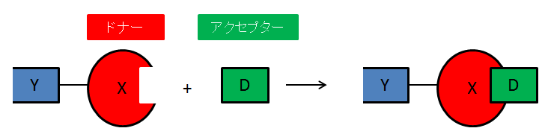
Introduction
● Halogen bond
Non-covalent interaction between halogen atom and Lewis base.
X = Halogen atom (Donor or Lewis acid)
Y = C、H、N、・・・
D = N、O、S、・・・ (Acceptor or Lewis base)
Donor
Acceptor

Slide 6
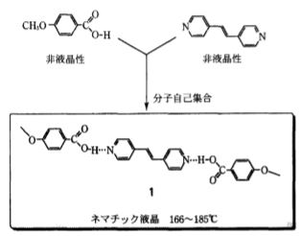
Introduction
● Supramolecular
・Non-covalent interaction by two different molecules
・Exhibit specific properties by retained raw molecule’s properties
Ex.) Nematic liquid crystal
Non-liquid crystalline
molecules gather to form
liquid crystalline molecules.
https://www.jstage.jst.go.jp/article/oubutsu
1932/68/5/68_5_541/_pdf

Slide 7
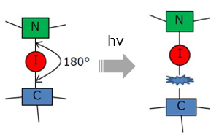
Why use iodine ?
● Iodine
・ Forms strong bond and interaction with Lewis base.
・ C-I bond can cut easily.
Ex.) External stimulated by light
 | Binding energies [kJ mol⁻¹]
C-F | 115
C-Cl | 83.7
C-Br | 72.1
C-I | 57.6
Expected to application for
light patterning

Slide 8
Light patterning by halogen bond
hν
Photo mask
C
C
C
C
C
C
C
C
C
C
C
C
C
C
C
C
I
I
I
I
I
I
I
I
I
I
I
I
I
I
I
I
I
I
N
N
N
N
N
N
N
N
N
N
N
N
N
N
N
N
N
N
Polymer membrane
Polymer membrane
Polymer membrane
Silicon substrate
Silicon substrate
Silicon substrate

Slide 9
Progress and Perspectives
Progress
・Made a supramolecular polymer by halogen bond.
・Measured thermal response by TGA.
・Measured photoresponsive by UV-Vis.
Perspectives
・Analysis of surface structure of supramolecular
polymer by halogen bond.
・Application for light patterning.

Slide 10
2. Experience in Malaya University
～ Synthesizing Polyaniline and characterization ～

Slide 11
Introduction
PolyAniline (PAni)
Ani (Monomer)
APS (Oxidant)
AOT (Dopant)
Ani：APS：AOT = 5：5：5
Mixing equal ratio
PAni
In this research...
① Synthesizing PAni
② Characterization
✓ FT-IR
✓ UV-Vis
✓ Conductivity
NH
n
Fig.1 PAni

Slide 12
Synthesis of PAni
HCl (200mL)
PAni
AOT
Stir (dissolved)
30 min
X3 washing
(100mL distilled H₂O)
2 layers
AOT (aq)
Ani
Drop by drop
PAni / AOT / APS
(aq)
Stir (2 h), 0 ℃
Ani / AOT (aq)
Toluene
(150 mL),
Overnight
2 layers
APS
Stir
HCl (33.33 mL)
0 ℃, 2 h
Shake
Ani / AOT / APS
(aq)
PAni / AOT / APS
(aq)
24 h (polymerization)

Slide 13
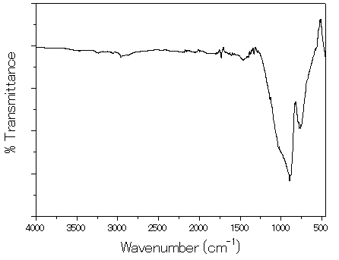
FT-IR spectra
Figure 1. FT-IR spectra
Out of plane C-H (～900), C-N Stretching benzenoid ring (～1200)
C=C benzenoid ring stretching (～1400), Qunoid stretching (～1600)
C-H stretching aromatic (～2900), N-H stretching (～3200)

Slide 14
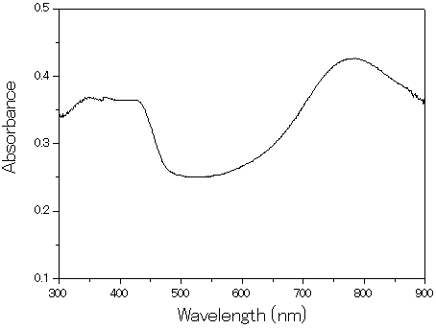
UV-Vis spectra
benzenoid
polaron
Figure 2. UV-Vis spectra
Peak | Description
347 nm | π-π transition of benzenoid rings
786 nm | Localized polaron bonds of protonated imines C=N (CP form of ES)

Slide 15
Conductivity
Table 1. Conductivity of PAni (thickness：3.0×10⁻⁴ cm)
 | Conductivity (S/cm)
① | 7.357 × 10⁻⁴
② | 6.419 × 10⁻⁴
③ | 8.702 × 10⁻⁴
④ | 2.447 × 10⁻⁴
⑤ | 7.719 × 10⁻⁴
Average | 6.529 × 10⁻⁴
Marian’s PAni | 2.008 × 10⁻⁴
The conductivity was up only a little...
✓ PAni was not sufficiently synthesized.
✓ The film thickness was too thin.

Slide 16
Conclusions
I synthesized Polyaniline, and did identification
using FT-IR.
Measuring UV-Vis, there are two remarkable peaks
by π-π transition of benzenoid rings and Localized polaron bonds of protonated imines.
I couldn’t drastically enhance the conductivity of Polyaniline...

Slide 17
3. Memories in Malaysia

Slide 18
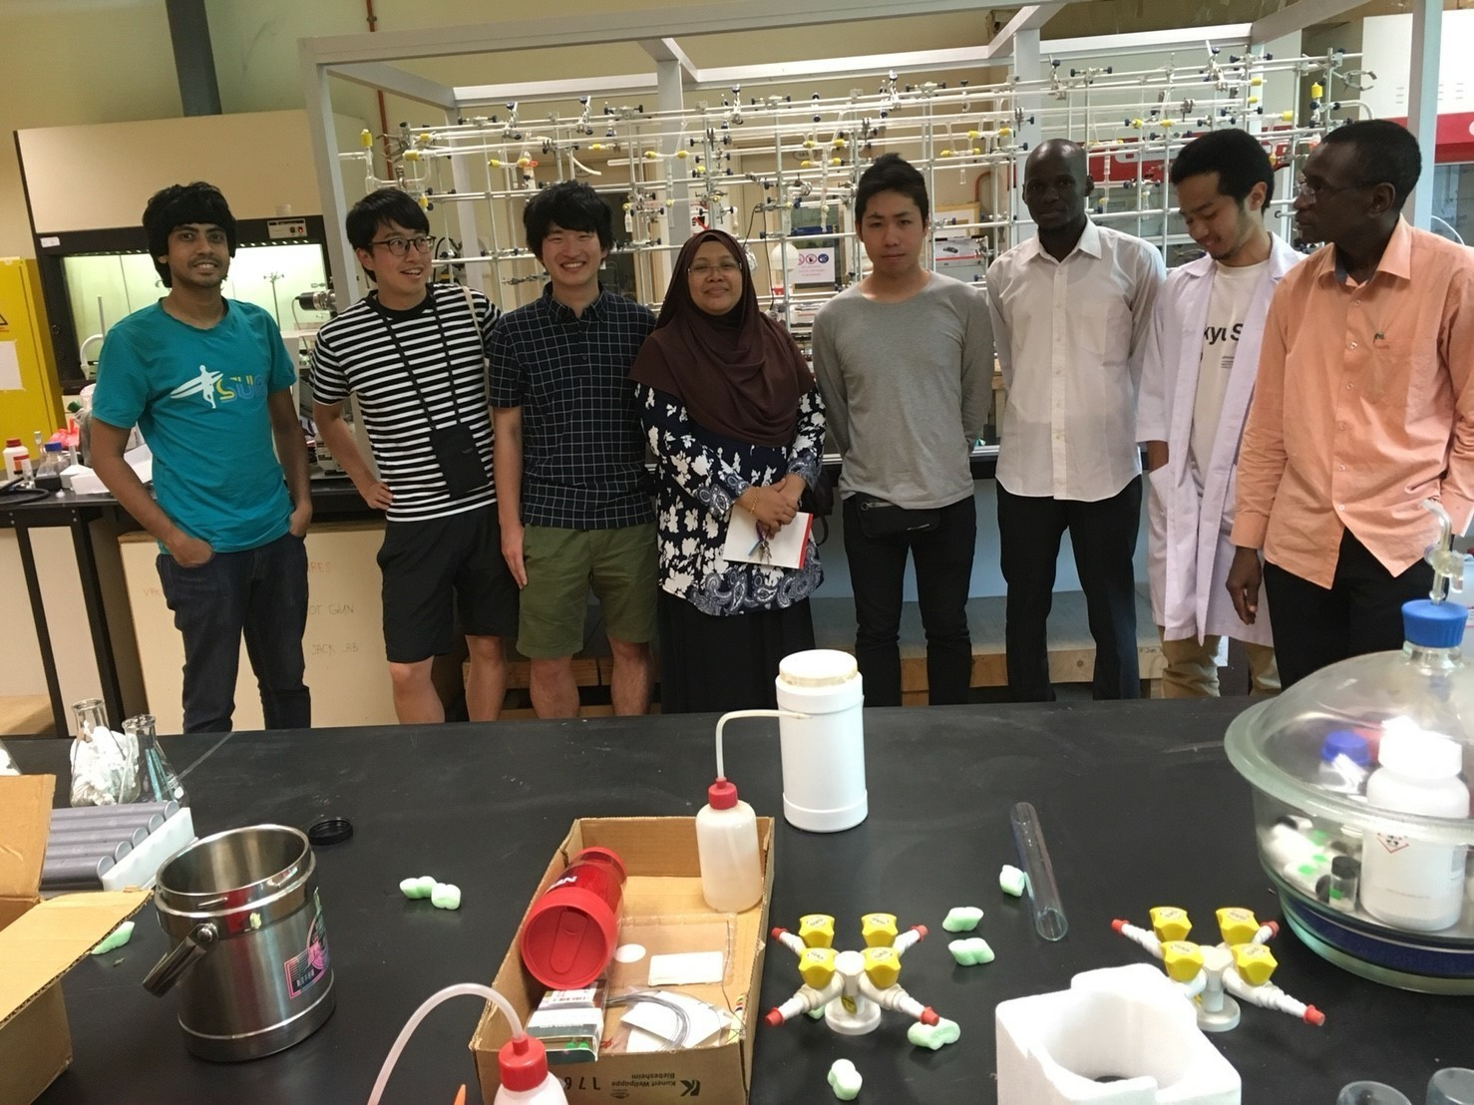
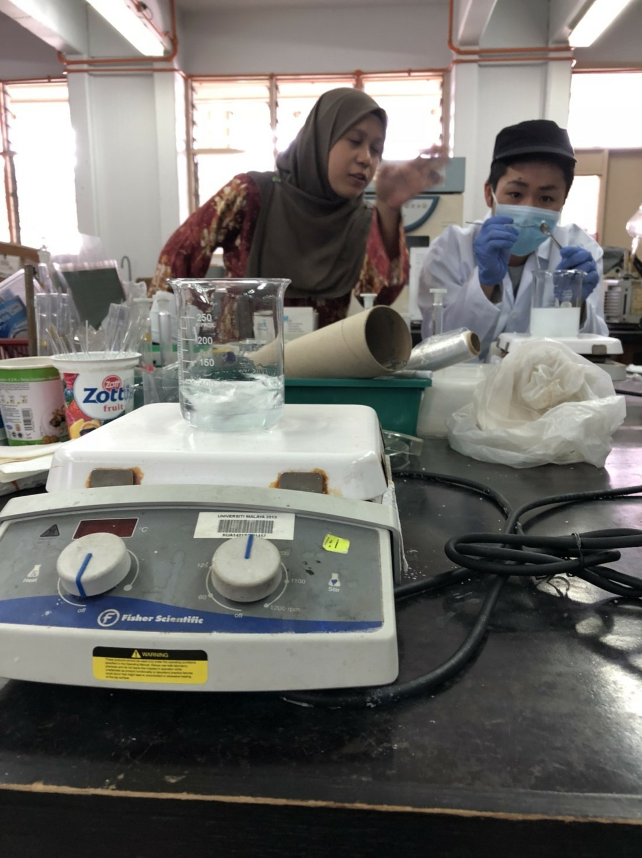
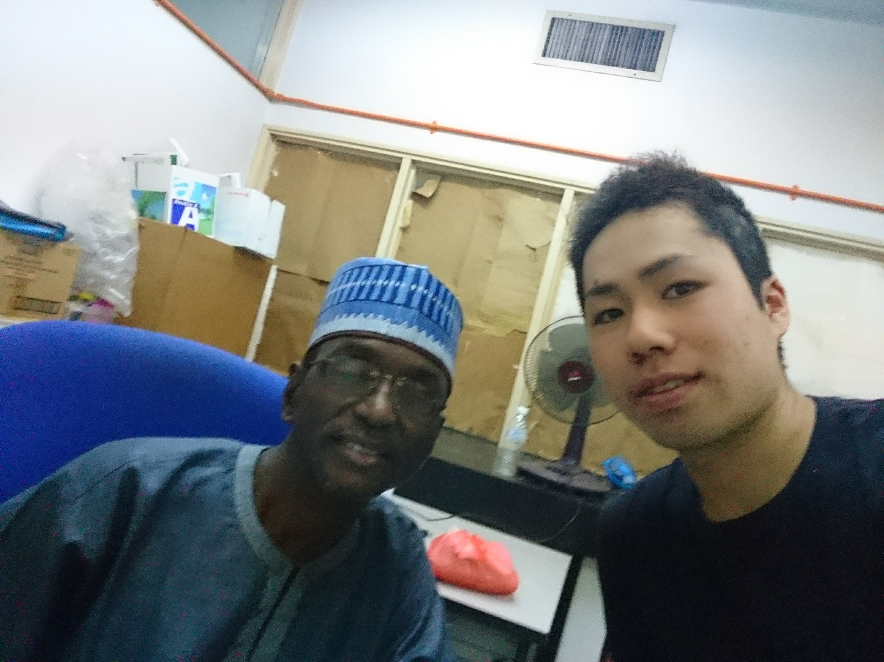
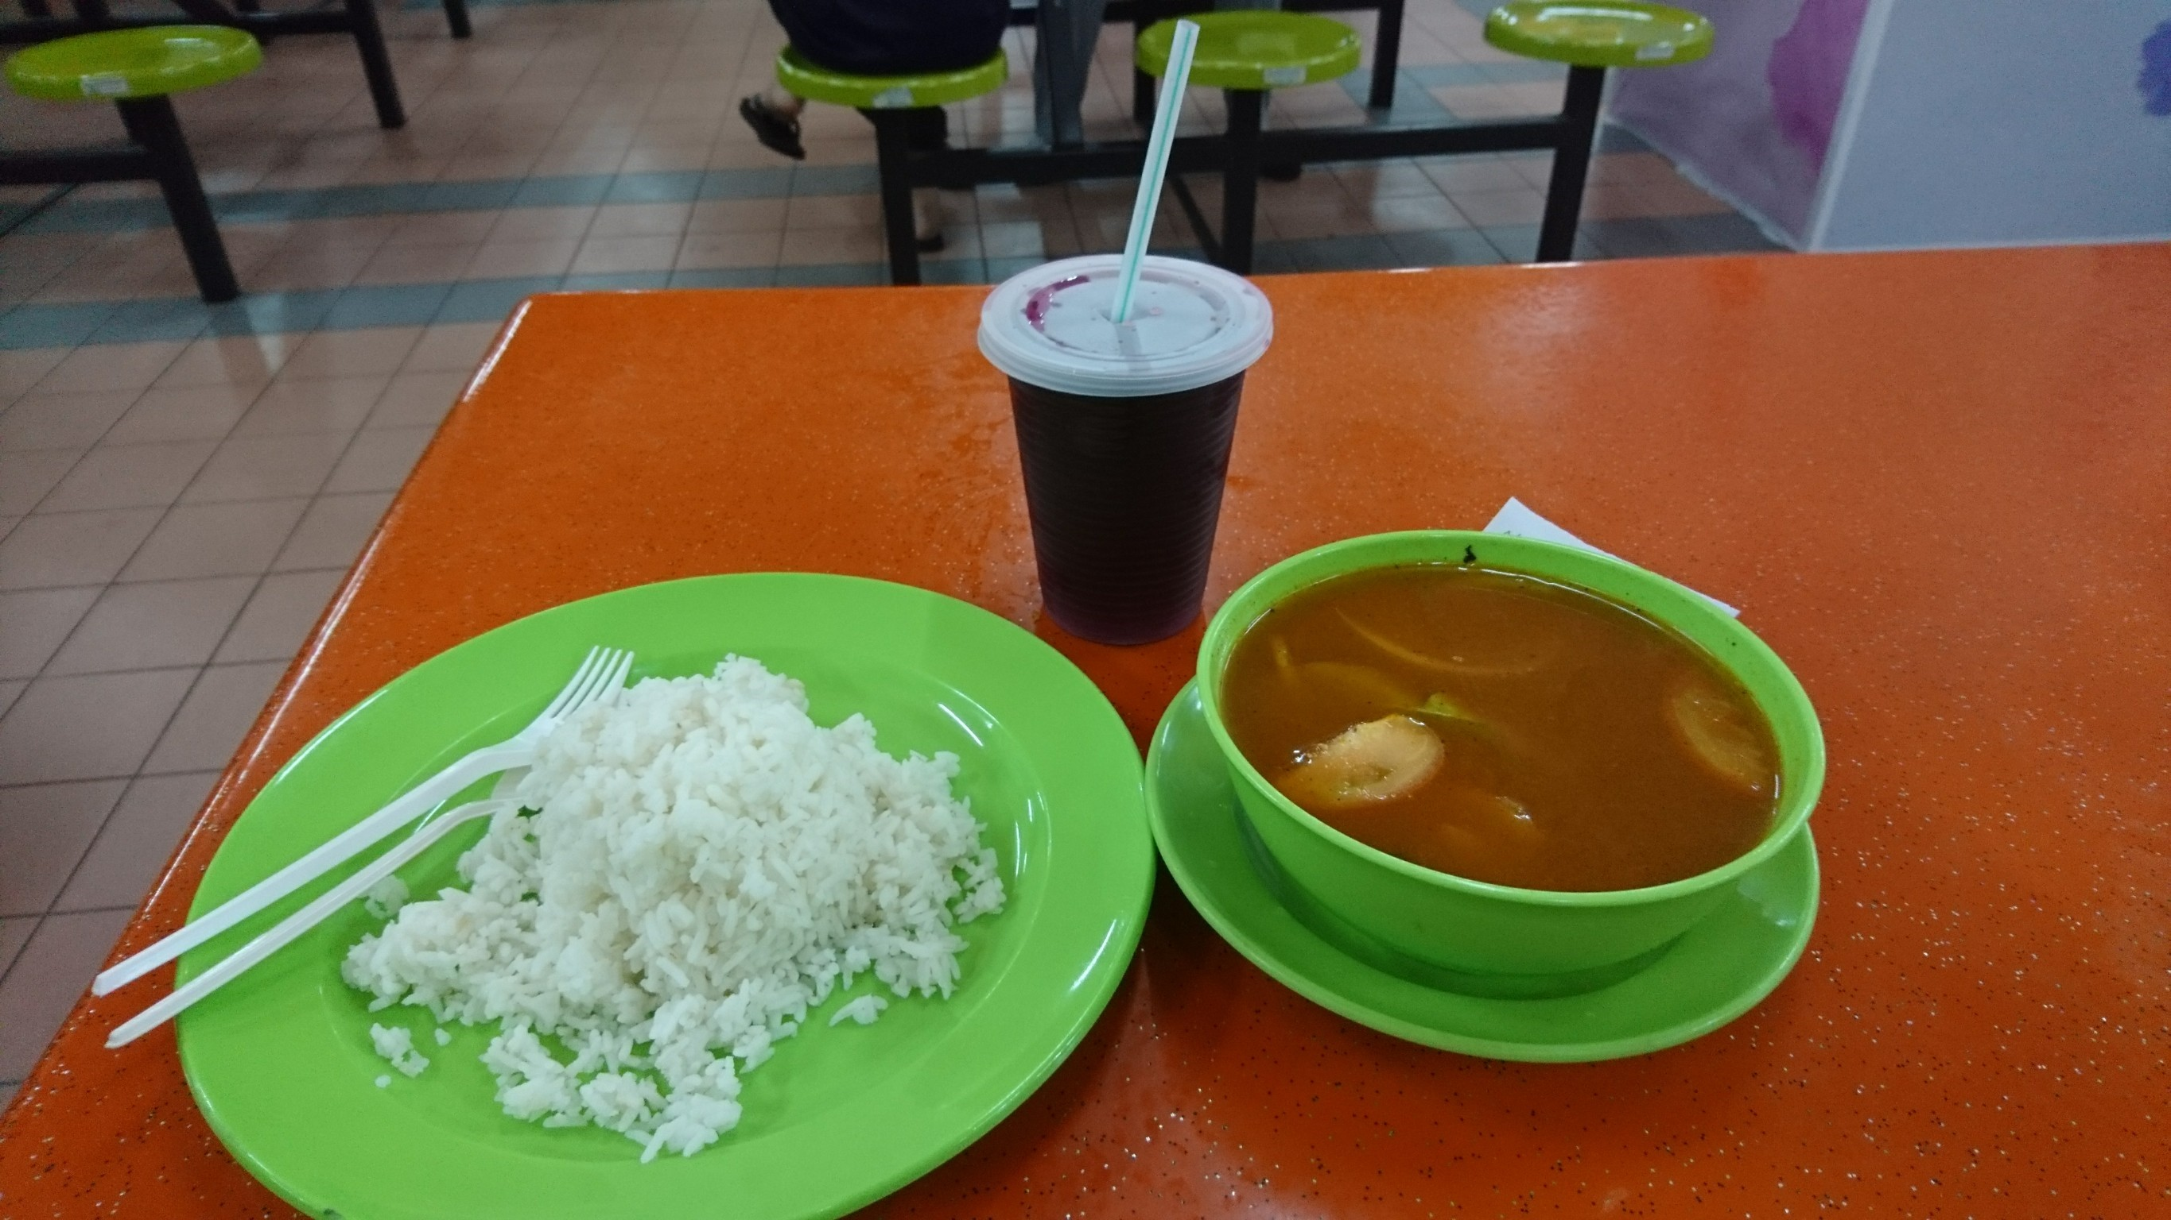
Campus Life

Slide 19
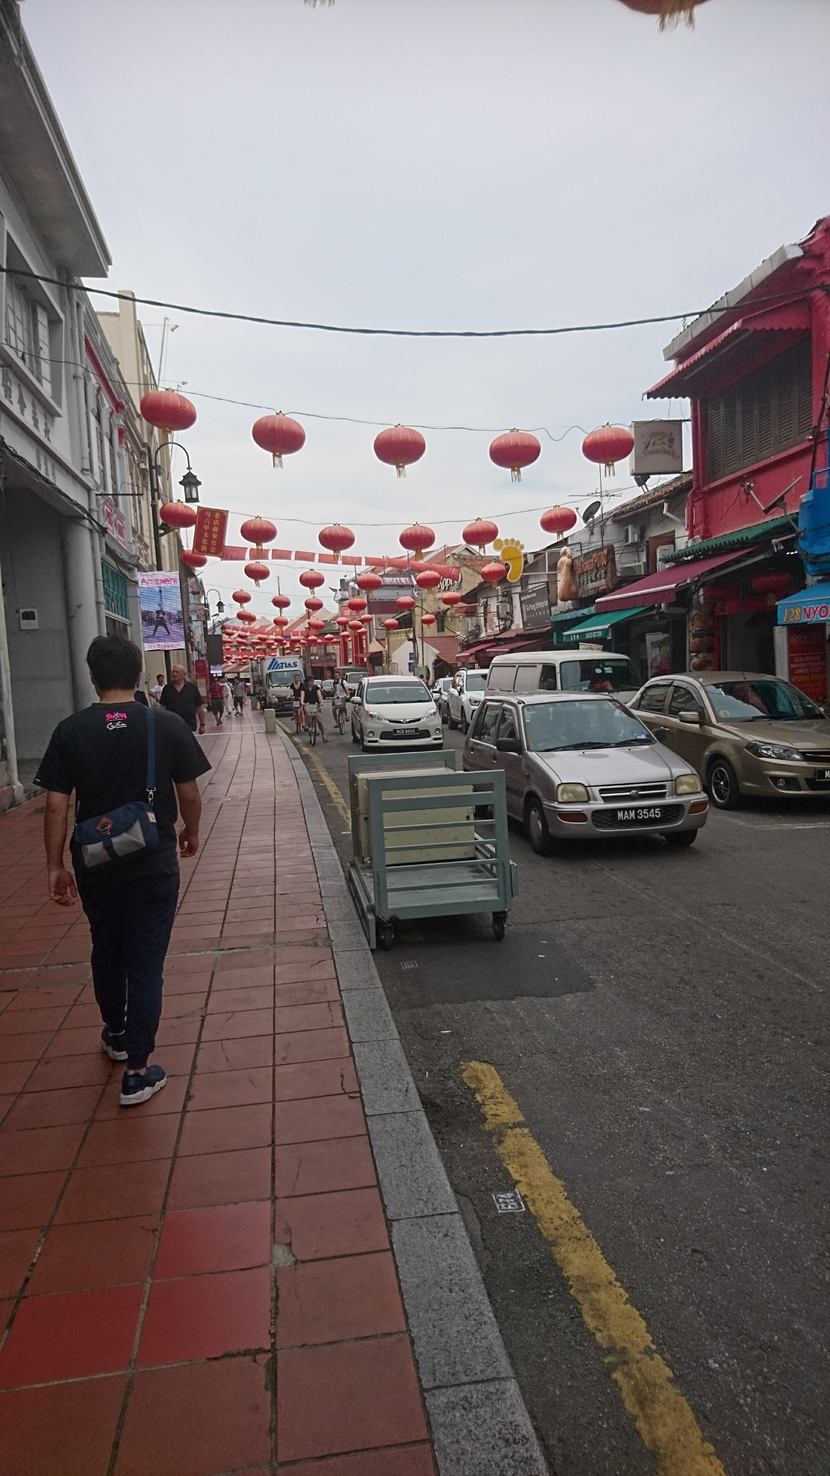
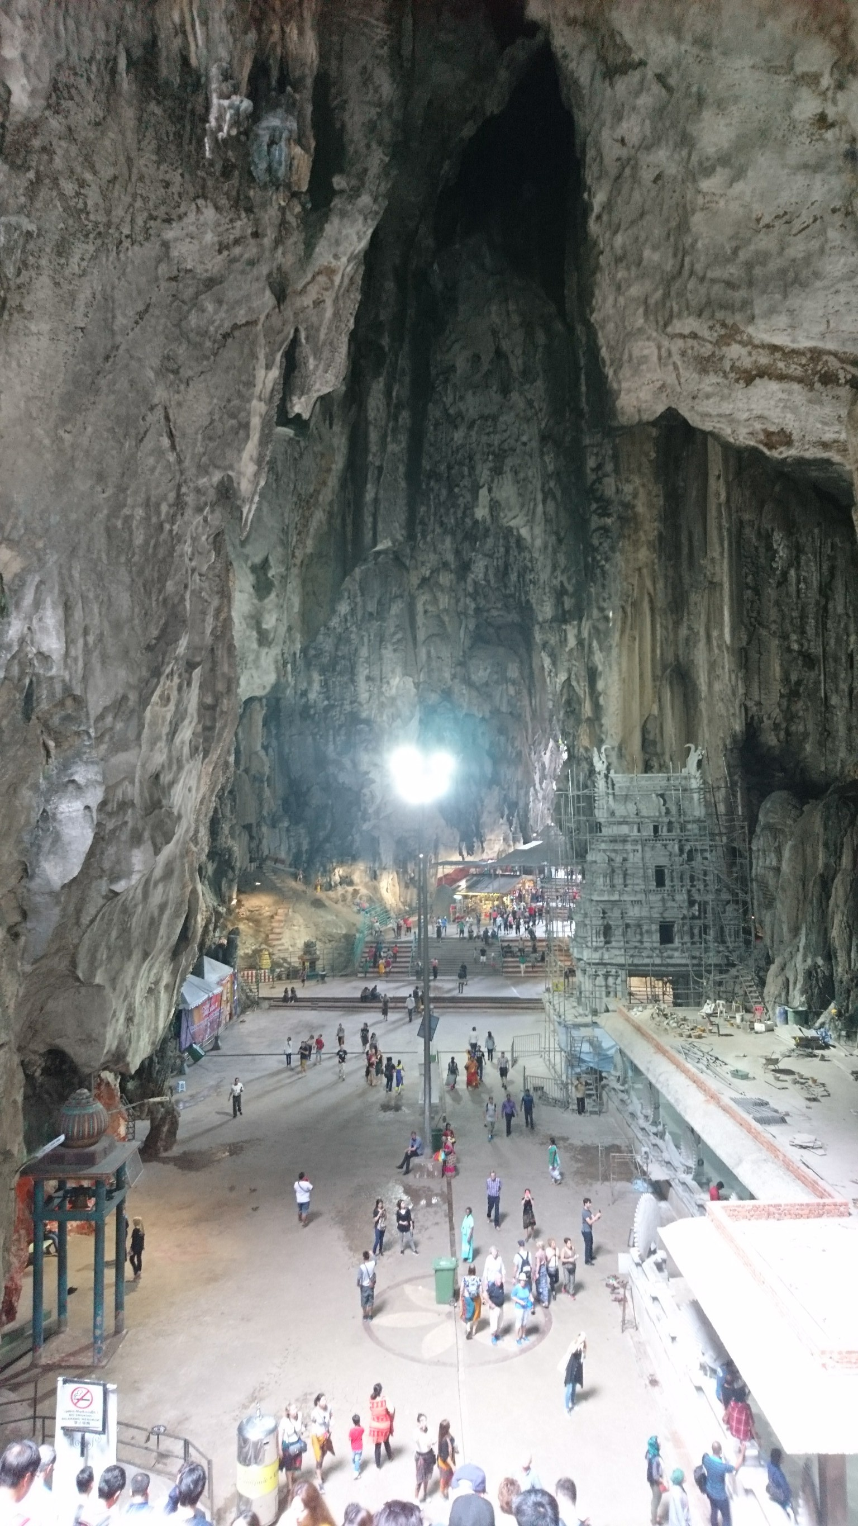
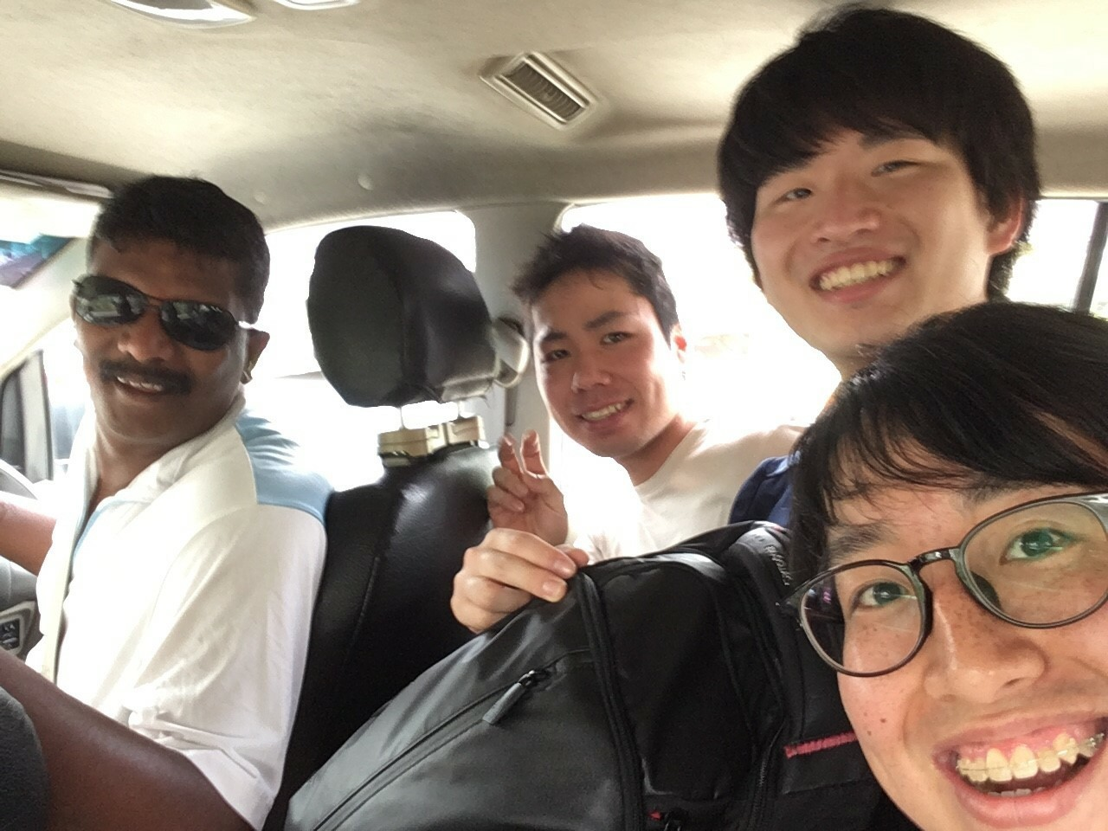
Tourism

Slide 20
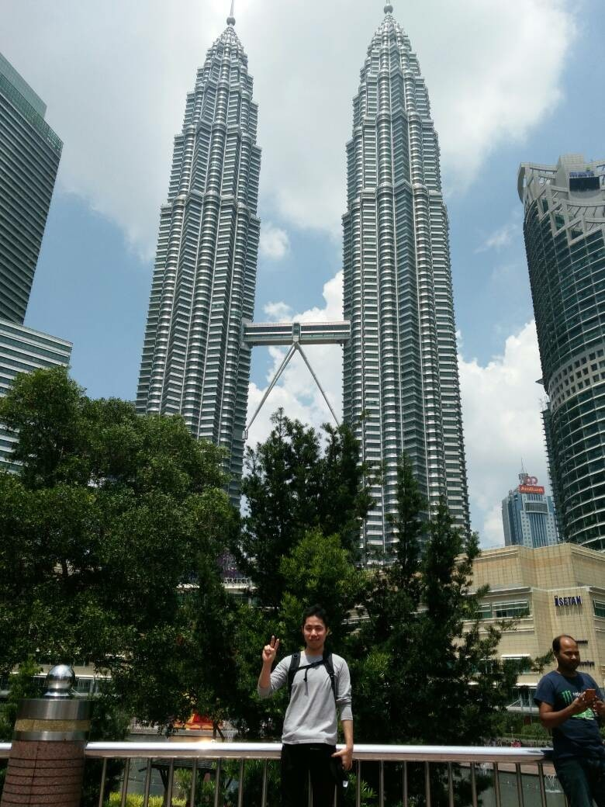
Conclusions
・I researched about
Polyaniline at Gan’s Labo.
・I learned the culture of
Malaysia and got a lot of
memories.
・Malaysian food is so spicy!!
I want to come to
Malaysia again!!

